Slide 1
Nonlinear Dynamical Systems Workshop
Tuesday Morning

Slide 2
Overview (8:30)
Self-Organization
Self-similarity
Measures of Self-Organization: Power Laws
Recurrences
Recurrence Plots
Recurrence Quantification Analysis (Part I)
Notes:
Did we get to self-similarity on Monday?

Slide 3
Self-similarity (if time)
The same at multiple (all) scales
Statistical self-similarity vs. actual self-similarity
Real data isn’t such a perfect fit
When is anything real a perfect fit?
Same process, though
Many things are self-similar
City maps
Circulatory system
Tree branches
Coastlines
Notes:
This slide is in the Tuesday morning stack

Slide 4
Dimension (if time)
There are many different dimensional measures
Geometric
Box counting
Lines
Hausdorff
Etc., etc.
Be sure you are consistent in your use
All are similar in their approach
Notes:
This slide is in the Tuesday morning stack

Slide 5
CYO & Discuss (8:35)
Plot and find the dimensions:
Crumpled paper
Whole sheet, then half sheet, then quarter sheet, etc.
NDSPaperCrumple
Can use any/all of the variables; three different people did the crumpling
Notes:
This slide is in the Tuesday morning stack

Slide 6
Discussion about Fractals (8:45)
Meaning of dimension?
Fractional dimension as a balance
Are fractals constrained random entities?
Are fractals endogenous entities?

Slide 7
Categorical Sequence Power Laws (9:00)
Not regression-style data, but time series data
Create a distribution of codes
Time series – dynamics – time scales?
Orbital decomposition (Guastello et al., 1998) to find appropriate time scale
Power Law Distributions
P(x) = ax^{-b}
Use ranks (x) and frequencies (P) for fit
Warning: Mathematical subtleties galore (Clauset et al., 2009)

Slide 8
Why do we care? (9:10)
Many self-organizing systems demonstrate power law distributions
Pincus et al.: Inverse power law demonstrates a balance between coherence and flexibility
Goldilocks principal mostly likely at work when it comes to the exponent
Goodness of fit may also be important

Slide 9
Power Laws (9:15)
How to fit them:
Log-log plots are a quick indicator
Fitting the log-log plot can be badly biased, but until one has theory that predicts a given exponent, it probably doesn’t matter
Many refinements (e.g., lower threshold)
Clauset et al. (2009)
Ongoing debates (lognormal vs. power law)
Warnings: Many different definitions
May not include negative signs
CDF vs. PDF

Slide 10
Fitting Power Law to Data (9:20)
The gold standard: Clauset et al. (2009)
Package poweRlaw
This is embedded in IPL_fit()
IPL_fit(…)
Use orbital decomposition, orbde(), first to determine appropriate scale, C
Notes:
Need to do OD????

Slide 11
Example (9:25)
Example (RJ data)
orbde(pull(read.csv("https://bit.ly/NDSMacro1")))
Find C
IPL_fit(pull(read.csv(https://bit.ly/NDSMacro1)),
<put C here>)
Interpretation
Method: C or L (Clauset or log-log)
Shape parameter (exponent)
R² (goodness of fit)

Slide 12
Developing Example (9:35)
Compare NDSMacro1 to NDSMacro2
Same small group, but several days later
Which C should be used?
Interpretation:
Goldilocks?
Change over time?

Slide 13
CYO & Discuss (9:45)
NDSMacro3 and NDSMacro4
Two days from a small group
Same class and days as NDSMacro1 and NDSMacro2, but different group
Compare to each other and to NDSMacro1 and NDSMacro2
NDSAFAR
Sequence of facial affects from a self video
“AFAR” – Automatic Facial Affect Recognition

Slide 14
Break (10:00)
We’ll start back up in 15 minutes
Notes:
9:45-10:00

Slide 15
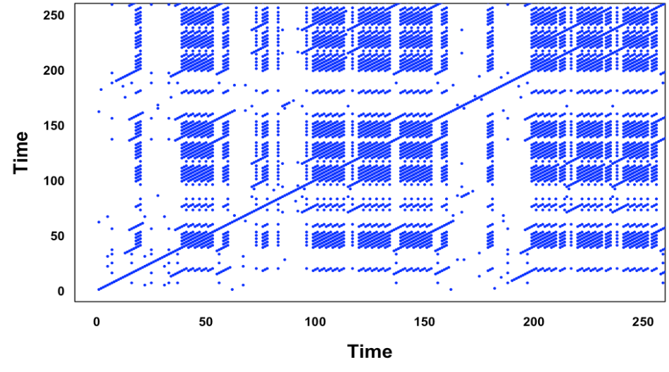
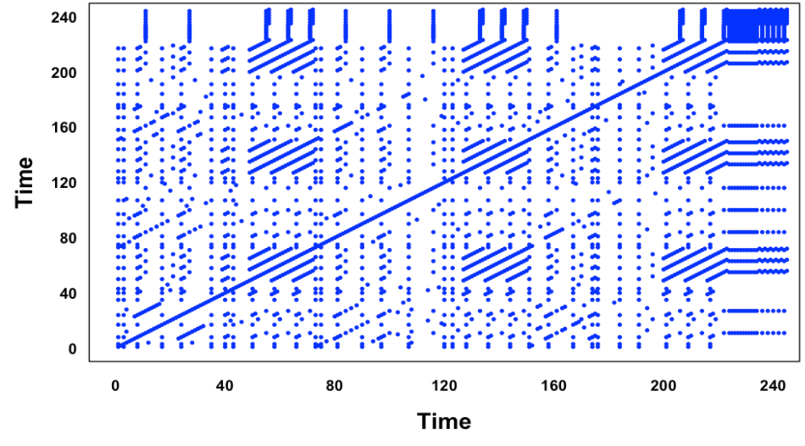
Compare these plots (10:15)

Slide 16
Compare these plots
Beatles’ “Let It Be”
Beatles’ “Revolution”

Slide 17
Recurrence Plot (10:25)
Show their creation
Copy text into text file (create in Rstudio) and save
Look! The right directory!
Cleaning text: prepareText()
Making it happen: crqa()
A gazillion parameters to set…ugh
Eventually we’ll get to things like “phase space reconstruction” and “embedding dimension” and “delay.” Try to ignore them for now
Plotting: plotRP()
Another gazillion parameters to set…ugh
Notes:
RQA example.Rmd has all of the parameters necessary.

Slide 18
Recurrence Quantification Analysis (10:45)
Metrics – 9 common ones
Recurrence Rate (RR) – density of recurrence points
Determinism (DET) – predictability from long diagonals
NRLINE – total number of diagonal lines
maxL or L_{max} – longest diagonal line
L – average diagonal line length (mean prediction time)
ENTR – Shannon entropy
rENTR – entropy normalized by number of lines
LAM – proportion of points forming vertical lines
TT – average length of vertical lines
We’ll look at these in detail after lunch
Notes:
Need to do each of these and annotate them in the file.

Slide 19
RP Metric Interpretations (1)
Recurrence Rate (RR)
Percent of dots (not including LOI)
Determinism (DET)
Fraction of recurrent points that form diagonal lines (>l_{min})
NRLINE
Total number of diagonal lines
Notes:
Bootstrapping ci in package

Slide 20
RP Metric Interpretations (1a)
Recurrence Rate (RR)
Percent of dots (not including LOI)
Determinism (DET)
Fraction of recurrent points that form diagonal lines (>l_{min})
NRLINE
Total number of diagonal lines
Notes:
Connect all these to RP
Bootstrapping ci in package

Slide 21
RP Metric Interpretations (2)
L_{max} (or D_{max})
Longest diagonal line
L (or D)
Average diagonal line
“Average time two segments of the trajectory are close to each other” (Marwan & Webber, 2015)

Slide 22
RP Metric Interpretations (2a)
L_{max} (or D_{max})
Longest diagonal line
L (or D)
Average diagonal line
“Average time two segments of the trajectory are close to each other” (Marwan & Webber, 2015)

Slide 23
RP Metric Interpretations (3)
Entropy (ENTR or ENT)
Shannon entropy (of diagonal line lengths); a measure of complexity and/or surprise
Normalized Entropy (rENTR)
Entropy divided by number of diagonal lines
More on entropy later

Slide 24
RP Metric Interpretations (3a)
Entropy (ENTR or ENT)
Shannon entropy (of diagonal line lengths); a measure of complexity and/or surprise
Normalized Entropy (rENTR)
Entropy divided by number of diagonal lines
More on entropy later

Slide 25
RP Metric Interpretations (4)
Laminatiry (LAM)
Percent of recurrent points in vertical lines (> l_{min})
Trapping Time (TT)
Average length of vertical lines
Notes:
The cheat sheet should have a high and low value RP for each metric.

Slide 26
RP Metric Interpretations (4a)
Laminatiry (LAM)
Percent of recurrent points in vertical lines (> l_{min})
Trapping Time (TT)
Average length of vertical lines
Notes:
The cheat sheet should have a high and low value RP for each metric.

Slide 27
RP Metric Interpretations (5)
Not calculated by crqa::crqa()
Can do each of the above as a function of distance to LOI
Useful for looking at periodicity
Trend (TND)
Regress RR on distance to LOI
Information about stationarity (TND near 0) vs. nonstationarity (TND far from 0)

Slide 28
RP Metric Interpretations (5a)
Not calculated by crqa::crqa()
Can do each of the above as a function of distance to LOI
Useful for looking at periodicity
Trend (TND)
Regress RR on distance to LOI
Information about stationarity (TND near 0) vs. nonstationarity (TND far from 0)

Slide 29
RP Metric Interpretations (6)
Not calculated by crqa::crqa()
Maximum vertical line (V_{max})
Stuckness – results in rectangles
And more…see Marwan & Webber (2015)

Slide 30
RP Metric Interpretations (6a)
Not calculated by crqa::crqa()
Maximum vertical line (V_{max})
Stuckness – results in rectangles
And more…see Marwan & Webber (2015)

Slide 31
Repository of this week (11:25)
Repository of everything: https://barneyricca.github.io/NDSWorkshop
This includes the data files
This includes the PPTX files, so you have some notes if you need them
This includes the scripts I write (posted after I write them)
But don’t peek
You’ll learn more if you don’t peek ahead of time
Entries may be edited during the workshop

Slide 32
Lunch
Send me your text files, please!
We’ll reconvene at 1:30

